Slide 1
BadUSB Botnet Attack
CSC 154 Project
Ryan Kozak, Tom Amir, Pawan Chandra

Slide 2
Objective
To create BadUSB devices, that upon plugin, infect victim computers with malware configured to join a botnet

Slide 3
Key Terms
Botnet - number of Internet-connected devices running bots to carry out attack
Command & Control Server - a computer controlled by an attacker is used to send commands
VPS – Virtual Private Server is a virtual machine sold as a service by an Internet hosting service

Slide 4
Overview
Using ”Build Your Own Botnet” framework for our botnet
Command and control server that is easily deployed and managed

Slide 5
Command & Control Server
Created a VPS on Digital Ocean to run our C&C server
Using an Ubuntu 18.04 droplet at the cost of $5 per month
Purchased the domain sheep.casa and directed it towards our C&C server

Slide 6
BadUSB Device
Purchased BadUSB (DigiSpark) devices via Amazon
Using 12 devices spread across team at $3 per unit
Programmed using Arduino
Infects Linux, Mac, and Window machines

Slide 7


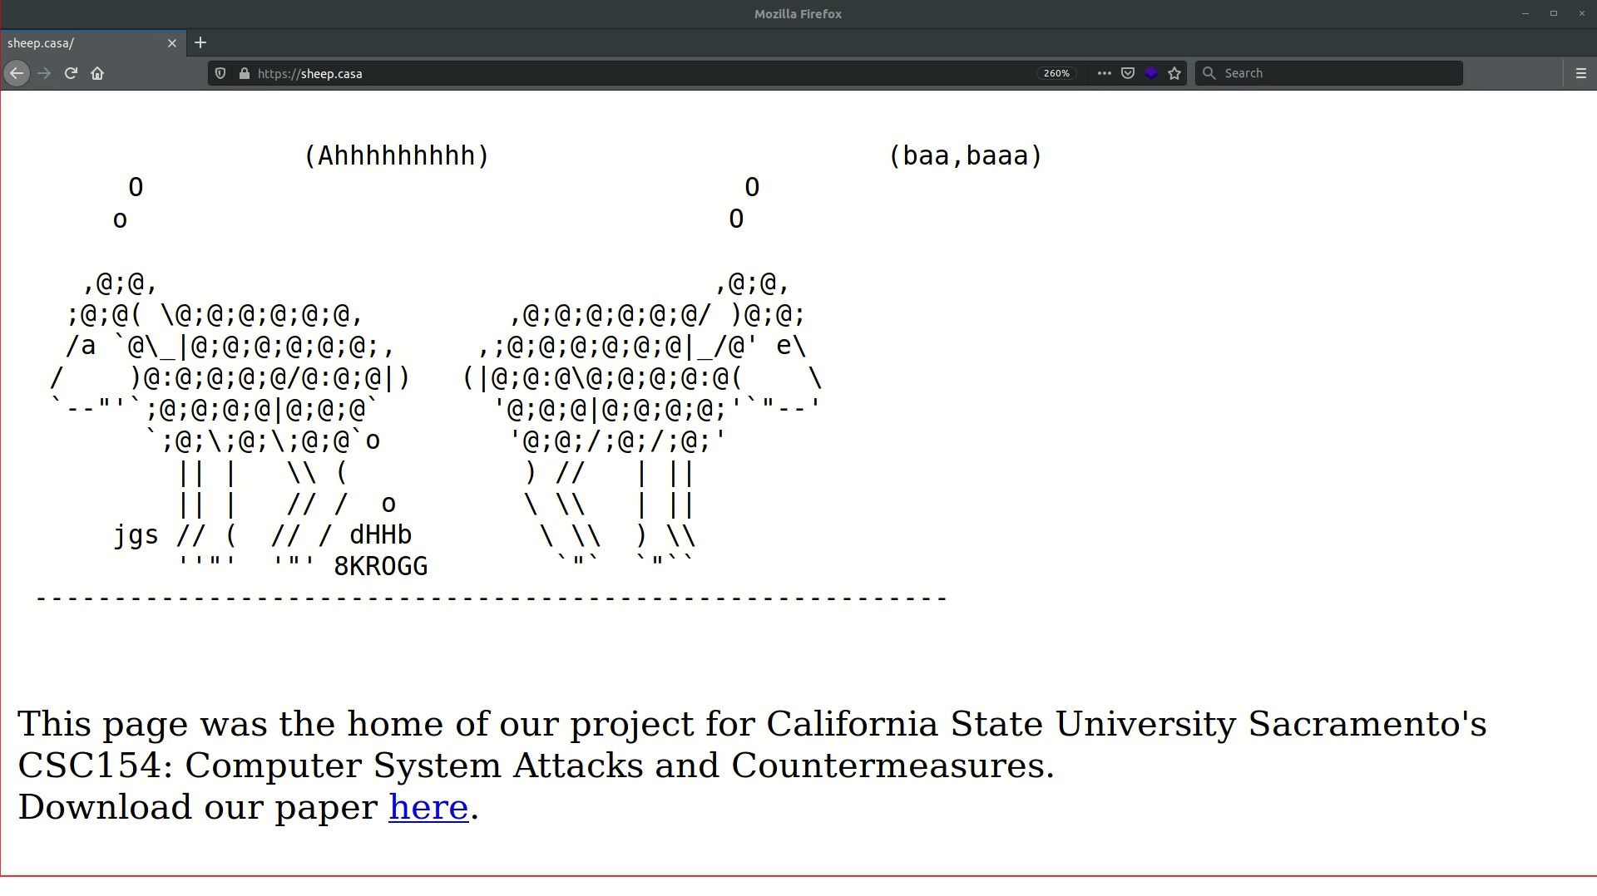



Live Demo

Slide 8
Lessons & Limitations
BadUSB devices were extremely successful on all platforms, despite our inability to use the same device for each
Botnet endeavor was less successful but we learned a great deal
If we had time to continue the project we're aware of what direction we would go in
Time was our greatest limiting factor for this project

Slide 9
Conclusion
Configured our BadUSB devices to infect Linux, Windows and OSX machines
Upon plugin, our device will execute a payload to join our Botnet
Ideally we would need to find a better botnet framework, or develop our own simple C&C server to handle reverse shells from victims

